Slide 1
HTTP Key Value Server
Dev Sonar 25M0824

Slide 2
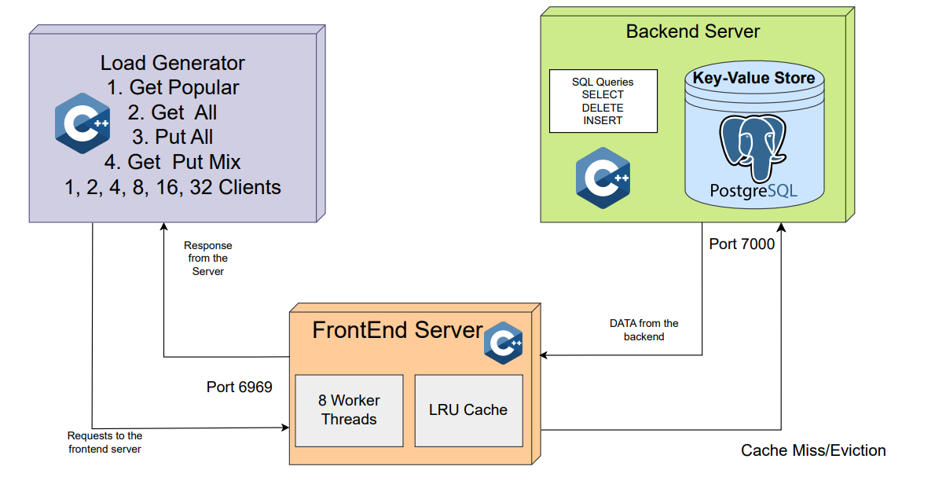
System Architecture
a

Slide 3
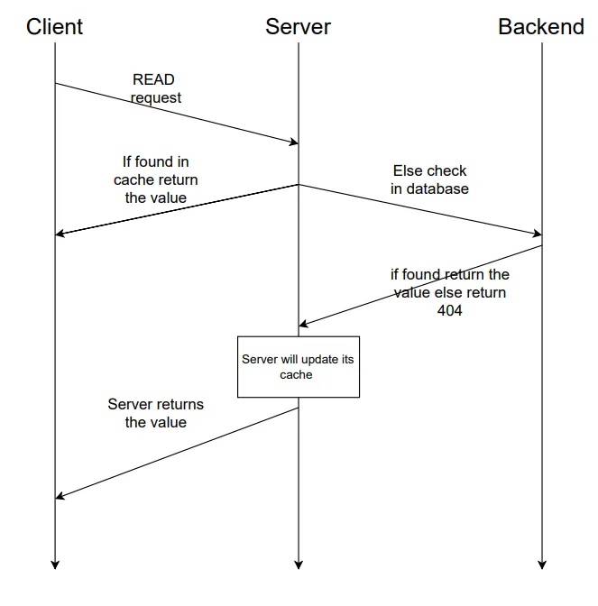
Sequence Diagram
(Request Flow)

Slide 4
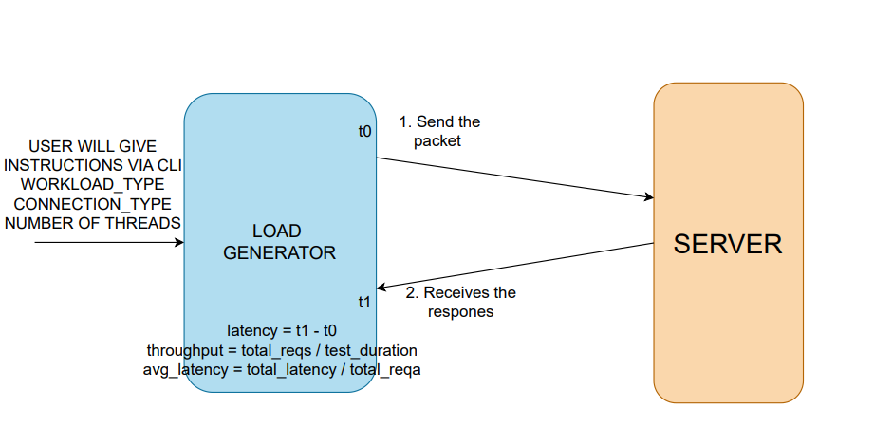
Load Generator Architecture

Slide 5
Load Test Setup
Everything was tested locally
Cloud methods were tried but they were not effective enough
The backend_server was pinned to a single core number : 3
The frontend_server was pinned to cores 4-7
The load_generator was pinned to cores 1-2
The bottlenecks for CPU and IO were seen using the htop and iostat command respectively
Processor : i5-10300H

Slide 6
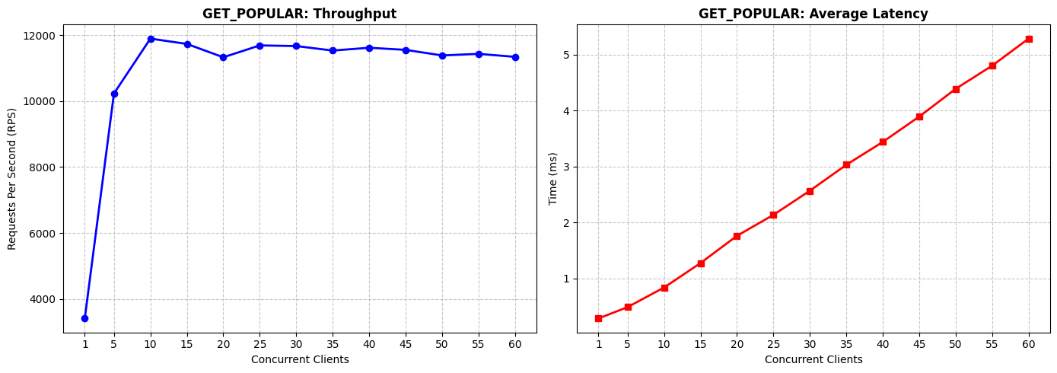
CPU Bottleneck
It was achieved while using the GET_POPULAR workload

Slide 7
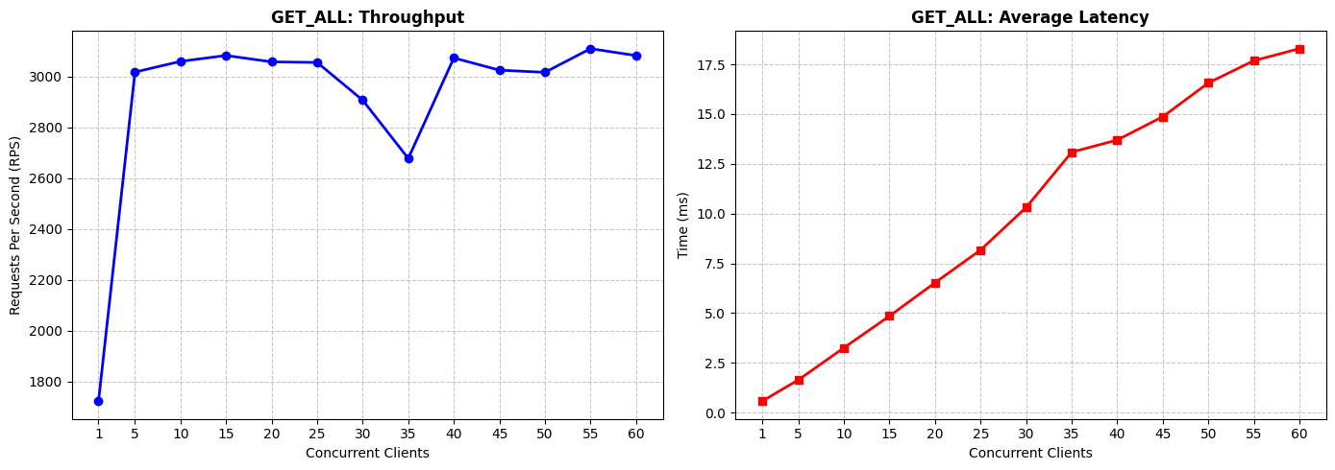
IO Bottleneck
It was achieved while using the GET_ALL workload

Slide 8
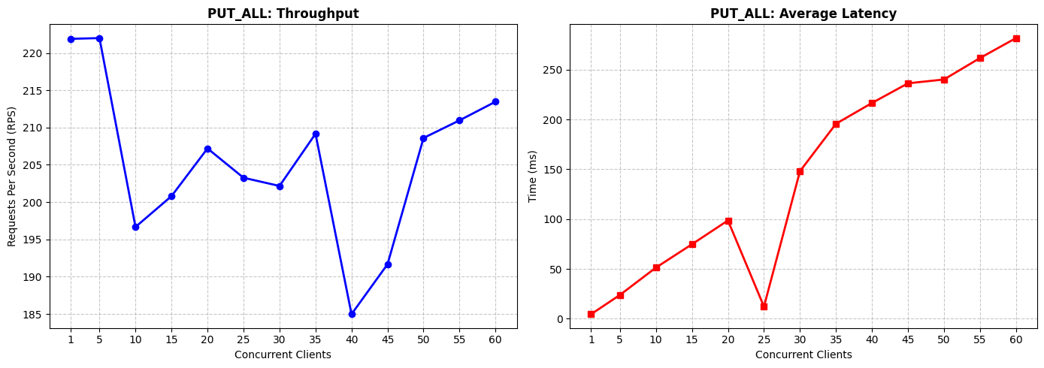
Other workloads :
PUT_ALL

Slide 9
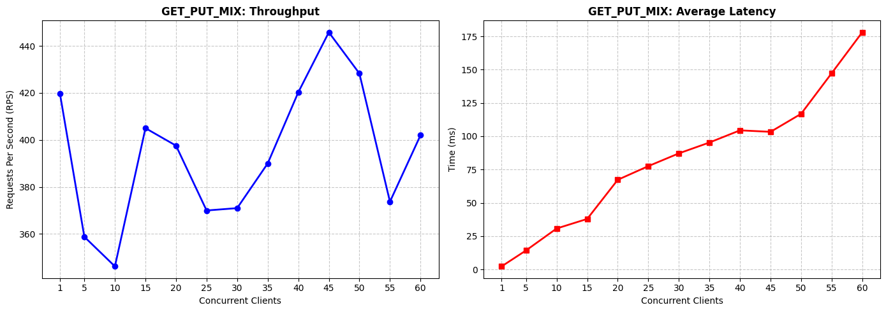
GET_PUT_MIX

Slide 10
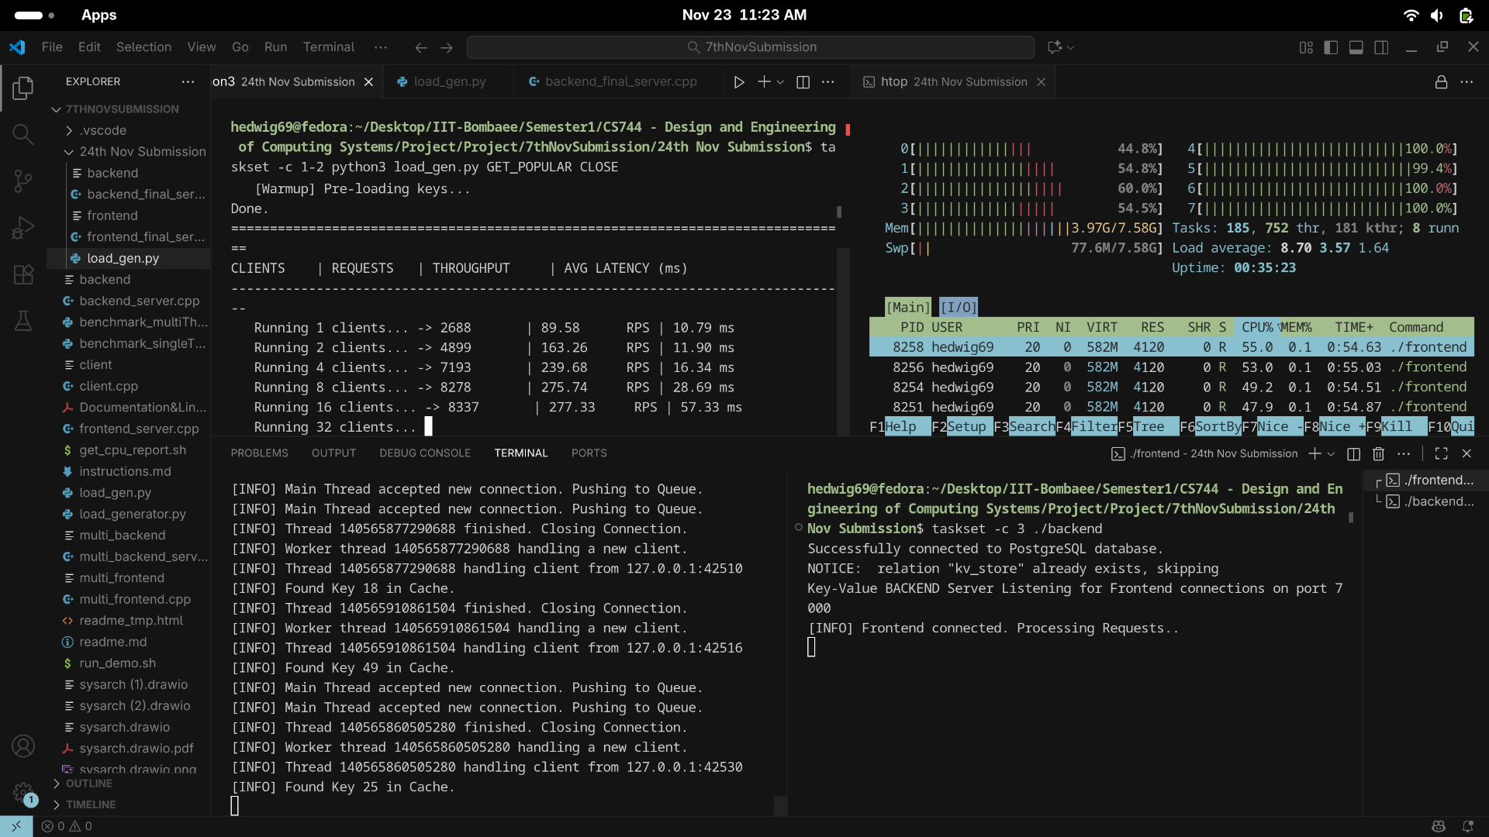
Some snapshots of performance testing :

Slide 11
